Slide 1
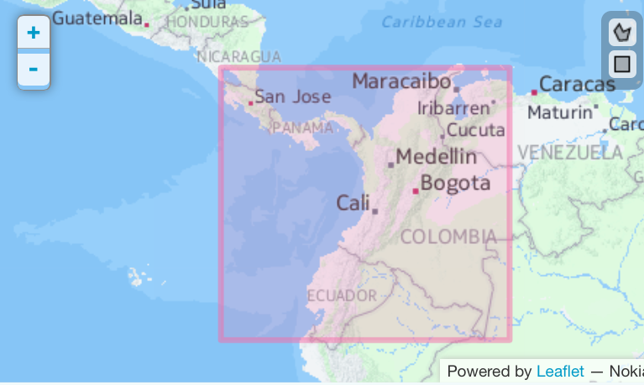


G e o C A T M
Cleaning geographical data
Reference polygon.
Download occurrences in reference polygon.
Define outer coordinates to know the limits of grid.
Top.coord.to.grid
Coordinates grid to assign altitude.
coord.grid.to.assign.altitude
NO
Table with species, coordinates, altitude from API, altitude from grid.
Coordinates grid.
Assign altitude from Altitude API of Google Maps.
Get.altitude.from.google
Estimate the difference between altitude from API and approximate altitude from grid.
Test.altitude
The
precision
of altitude grid is good,
(% of inaccuracy)
YES
Groups | # Occurrences
Amphibia | 125116
Aves | 2331760
Mammalia | 70313
Reptilia | 39769
Occurrences
Darwin core 1.2 format.
Random sample data to test altitude.
Sample.to.test.altitude
(%) Random sampled occurrences.
Show: Statistics and Histogram:
altitude difference.
Choose and read columns from Darwin core 1.2 format.
Choose.and.read
Delete species
Delete occurrences.
Check distance between distributional points of a species and print some statistical measures.
Statistic.distributional.points
Distributional statistics.
YES
YES
Start / Finish
Show: initial amount of species and occurrences.
Species table with occurences.
Join tables with georeferenced
occurrences.
Species outside
Work distributional
Range.
NO
Check occurrences outside of real distributional range of a species.
Check.occurences.outside.range
Occurrences outside of range.
NO
Species table with clean geographic data.
Write file to Martitracks software vr 0.67b ¹
Write.Marti
Internal process
Predetermined
process
NO
Use
altitudinal range.
YES
Individual files: species with georeference.
Check species with distribution in other areas.
Check.sp.outside.continent
Groups | # Species | # Occurrences
Amphibia | 200 | 6973
Aves | 488 | 90517
Mammalia | 99 | 2732
Reptilia | 70 | 3202
Write TNT matrix: Parsimony Analysis
Endemism (PAE).
Matrix.to.PAE
Input file to track analysis.
Alternative
process
YES
Decisions
Assign altitude to coordinates from altitude grid and Cut the range.
Assig.alt.and.Cut
Georeference
dismo::Biogeomancer ³
Check ISO countries for each coordinate.
Check.ISO.countries
Parsimony Analysis Endemism (PAE).
PAE.Analysis
Write input file from Martitracks file to NDM/VNDM ⁴
Marti.to.Vndm
Altitudinal Range:
From 0 to 1000 m.s.n.m.
Manual
process
Species outside of altitude range.
Species inside of altitude range.
Check localities order and delete localities with errors.
Check.localities
Check coordinates
Latitude: -90º to 90º
Longitude: -180º to 180º
Check.coordinates
Read and graph the PAE results.
Read.and.graph.PAE
Input file to analysis of endemism using optimality criterion.
Input file
PAE Results.
Show data
in scream
Filter exotic species.
SIGNI.foreign.sp
Individuals files: species without georeference.
NO
Species with georefereced occurrences.
YES
Individuals files: species with georeference.
Make Analysis in NDM/VNDM.
Output file
Groups | # Species | # Occurrences
Amphibia | 413 | 46261
Aves | 622 | 252290
Mammalia | 267 | 22878
Reptilia | 112 | 16929
Output files
Exotic species list.
Non-exotic species list.
List of species in polygon.
Download of species from API GBIF.
GBIF.sp.in
Species individual file.
Read VNDM output file in .Div form.
Read.polygon.div.format
Output files VNDM .Div format (DivaGis ²).
Groups | # Species | # Occurrences
Amphibia | 927 | 116344
Aves | 2430 | 2318306
Mammalia | 602 | 59005
Reptilia | 681 | 37917
Data counts
Convert
polygon .Div format to
polygon .shp format.
Div.to.Shp
abc
Range wide spread species.
VNDM areas in .Shp format.
Function name
Distributional mega-databases in electronic format are an important source of data for understanding global biodiversity. The most used is the Global Biodiversity Information Facility (GBIF) that could be a data source for many analyses, usually, at continental scale. Despite the advantages that the free databases have, it has been very difficult to control the error inherent in handling the data, therefore the aim of this work was to develop a library in R platform (GeoCATM), to deploy a cleaning tool for the systematic debugging of occurrences by reducing the noise or eliminating the "junk" data downloaded from GBIF.
GeoCATM supports input/output formats for track and endemism analyses, therefore an intuitive pipeline
could be used to perform all biogeographical analyses using the library.
Using the Choco area as the reference polygon, we downloaded from GBIF all occurrences for four vertebrate taxa vertebrates (Amphibia, Mammalia, Aves, and Reptilia), then we depurated the data using GeoCATM.
For the data used, the cleaned occurrences range from 12% of the original GBIF data in Mammalia, to a maximum of 35% in Aves, with 21% average for the four taxa used. These figures are important because it is considered that most of the GBIF data are unreliable, but with a systematic cleaning and debugging is possible to minimize and reduce the error or bias when a distributional analysis is performed.
This package was developed in R programming language, and could be downloaded from:
https://github.com/alarconvv/GeoCATM.git
References:
[1] Echeverr ́ıa-London ̃o, S. y D. R. Miranda-Esquivel, 2011 Plos One 6:18460.
[2] Hijmans, R. J., L. Guarino, C. Bussink, P. Mathur, M. Cruz, I. Barrentes y E. Rojas, 2005. http://www.diva-gis.org.
[3] Hijmans, R. J., S. Phillips, J. Leathwick y J. Elith, 2013. http://CRAN. R-project.org/package=dismo
[4] Szumik, C. A. y P. Goloboff, 2004. Systematic Biology 53:968–977.
R-Alarcon, Viviana*; Miranda-Esquivel, Daniel R.**
*alarconvv@gmail.com; **dmiranda@uis.edu.co
Laboratorio de Sistemática y Biogeografía
Universidad Industrial de Santander
Santander – Colombia

